Slide 1

Namma Yatri Customer Satisfaction and Service Efficiency

Slide 2
Problem Statement
To provide actionable insights to the management of Namma Yatri focusing on improving:
The Ride industry facing challenges like trip cancellations, demand supply mismatches, fare fluctuations. This analysis aims to develop Power BI dashboard to optimize operations and enhance customer experience.
Objectives
Analysed ride patterns to identify key patterns
Optimize fare pricing pattern using data insights.
Improving driver allocation based on demand supply trends.

Slide 3
Approach & Tools Used
Data cleaning & transformation in Power Query.
Data Modelling & creating relationship between the tables in Power BI desktop.
Dax calculations for important KPI’s
Dashboard creating & Insights Extractions.
Business Recommendations & implementations.

Slide 4
Data Source
Trips table with the following variables (Trip ID, Fare, Duration, Distance, Driver ID, Customer ID).
Trip Details table with the following variables(Customer interactions, Cancellations, Completions).
Payment Methods table with the following variables (Cash, UPI, Debit Card).
Assembly table with the following variables (Pickup & Drop Zones).

Slide 5
KPI Dax Logic
fare_per_km = SUM(Trips[fare]) / SUM(Trips[distance])
Customer not Cancelled = (CALCULATE(COUNT(Trip_Details[trip_id]), FILTER(Trip_Details, Trip_Details[customer_not_cancelled]=1)))/COUNT(Trip_Details[trip_id])
Customer_Cancelled = (CALCULATE(COUNT(Trip_Details[trip_id]), FILTER(Trip_Details, Trip_Details[customer_not_cancelled]=0)))/COUNT(Trip_Details[trip_id])
Driver Cancelled = (CALCULATE(COUNT(Trip_Details[trip_id]), FILTER(Trip_Details, Trip_Details[driver_not_cancelled]=0)))/COUNT(Trip_Details[trip_id])
Driver not Cancelled = (CALCULATE(COUNT(Trip_Details[trip_id]), FILTER(Trip_Details, Trip_Details[driver_not_cancelled]=1)))/COUNT(Trip_Details[trip_id])

Slide 6
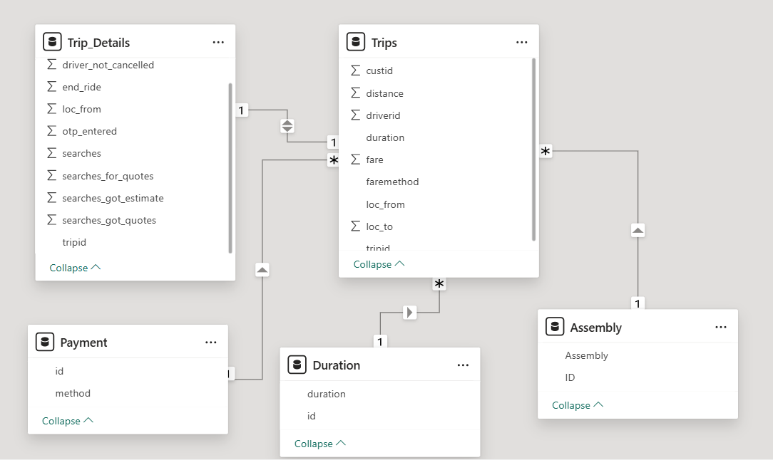
Data Modelling in Power BI
Removed duplicates and handled missing values.
Established required relationship between the tables using right cardinality.
Updated data type of the columns in the etire dataset.
Created required calcualtions where ever it is required.

Slide 7
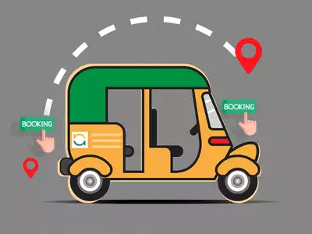
Business Insights
High drop off rates during fare estimates – Implementing predective pricing model.
Demand supply gaps in key locations – Increasing drivers allocation in hight demand locations.
Fare spikes during peak hours – Optimizing dynamic fare pricing for all the rides.
Digital payements are higher but still cash payments almost equal – Providing offers for digital payment incentives.

Slide 8
Improvements Required
Increasing demand supply matching to reduce ride confirmation wait time.
Fare obtimization to balance affordability of rides and increase revenue.
Improving performance of the drivers through better allocation of location.
Increating digital payments through targeted incentives.

Slide 9
Conclusion
Data driven insights helps optimize rides operations.
Giving best offers to the regular customers to reduce cancellation from regular customers and boost customer retentions.
Smart allocation of the drives at the main locations to improve the efficiency and service quality.
Giving incentives to the drives who allocated at the peak hours to reduce the drivers cancellation.

